Slide 1
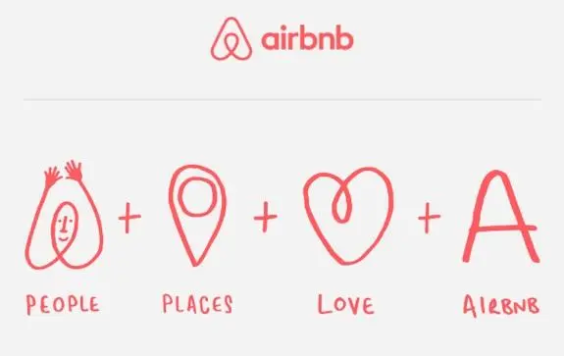
Sentiment Analysis of Airbnb Guest Reviews
RAGHAV ANEJA 0811583

Slide 2

INTRODUCTION
Airbnb was born in 2007 when two Hosts welcomed three guests to their San Francisco home.
Since then, it grew to over 4 million Hosts who have welcomed over 1.5 billion guest arrivals in almost every country across the globe.
Every day, Hosts offer unique stays and experiences that make it possible for guests to connect with communities in a more authentic way.

Slide 3
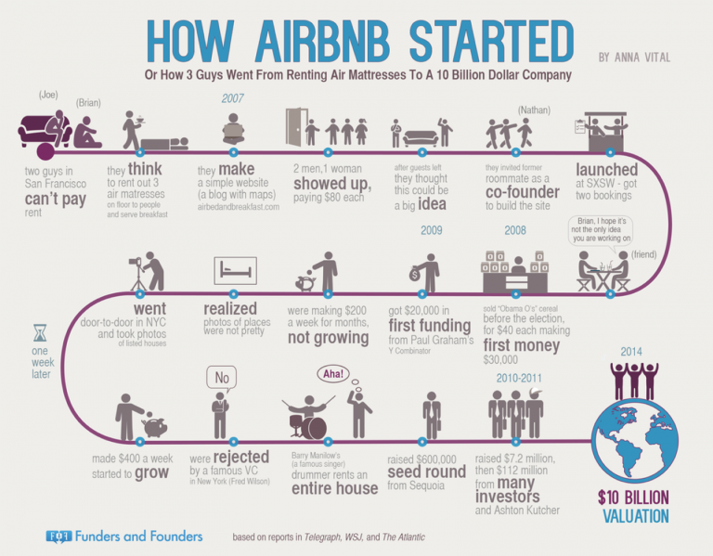

Slide 4

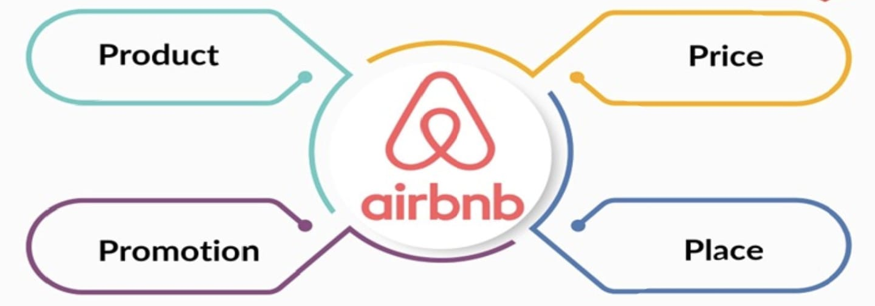
4 P’s for Airbnb Marketing Strategy
Platform that connects hosts offering place range from shared rooms to private islands with guests seeking places to stay.
Initially it priced accommodations below hotel rates. Airbnb charges a service fee of 3% for hosts and 14.2% for guests.
Promotions are done to create social buzz about the Airbnb brand through social media accounts and word-of-mouth.
Airbnb boasts >7M active listings in 220+ countries, with 4M+ hosts globally as of 2022/23.

Slide 5
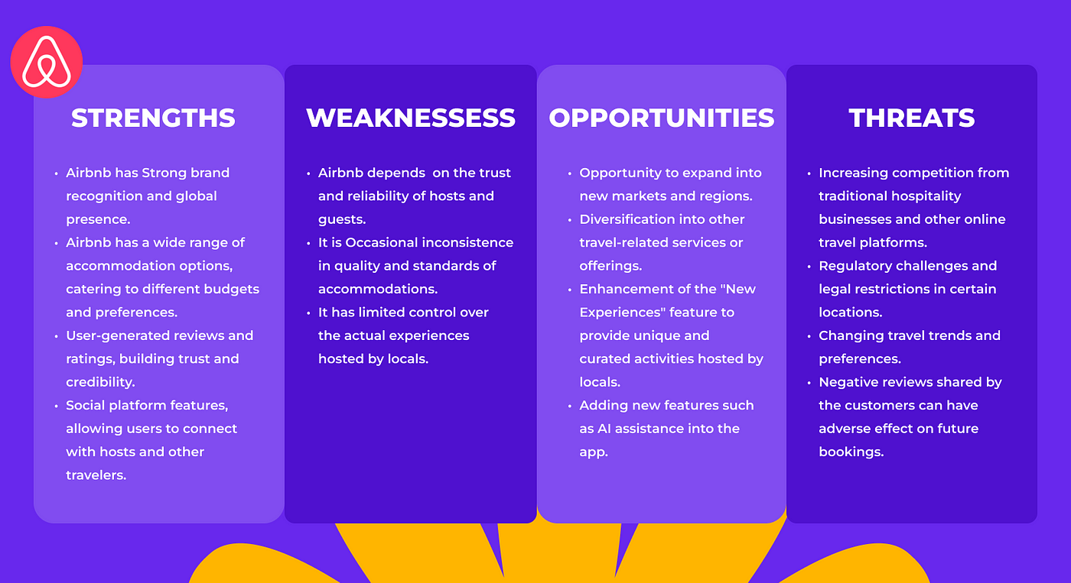
SWOT ANALYSIS

Slide 6
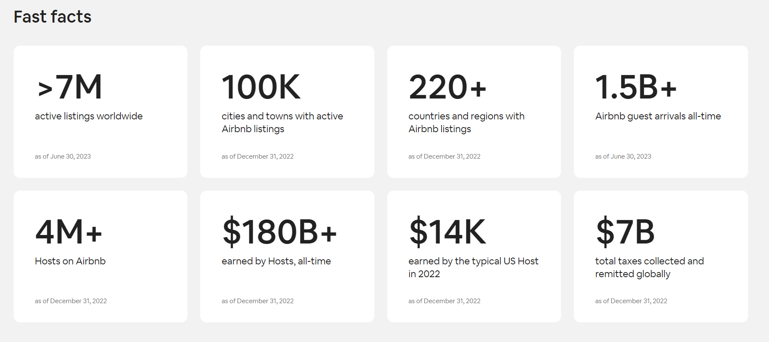
CURRENT MARKET ANALYSIS

Slide 7
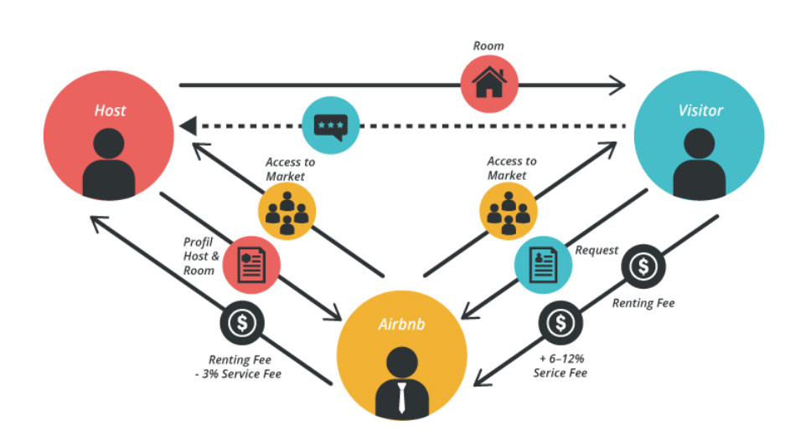
Methodology & Visualization

Slide 8
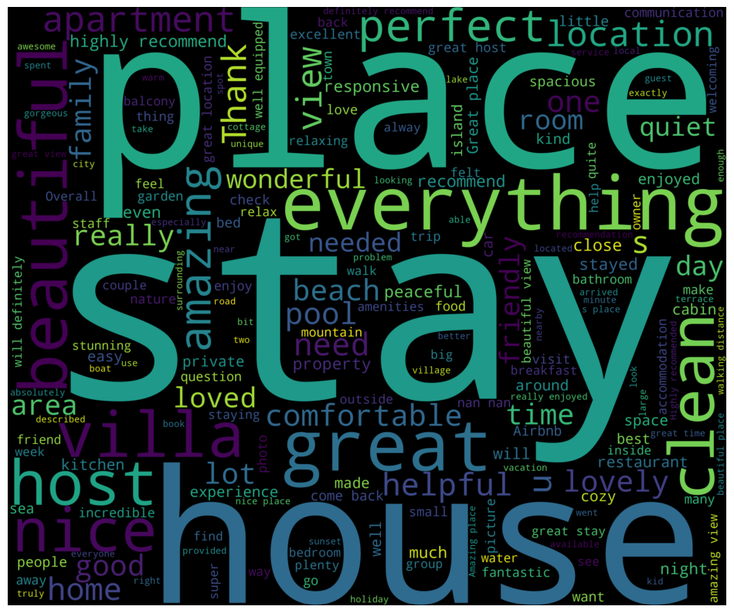
DATA EXPLORATION
Most Frequent words used in the guest reviews

Slide 9
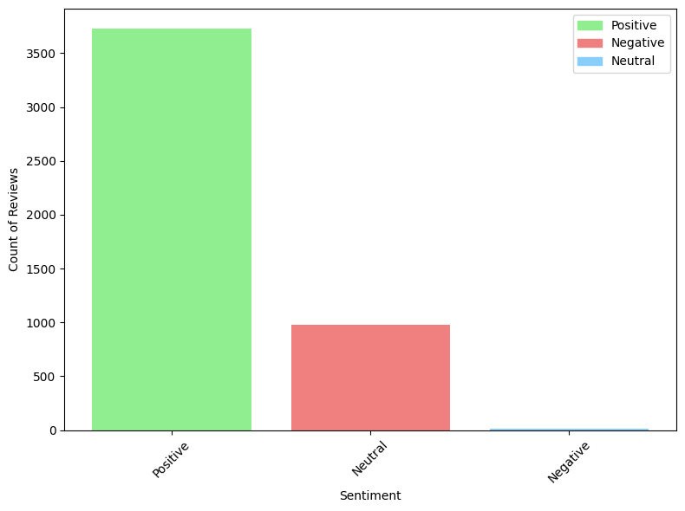
SENTIMENT ANALYSIS
The graph shows the distribution of sentiments as positive, negative or neutral. We have mostly Positive reviews(79%), 20.7% neutral and 0.3% negative reviews.

Slide 10
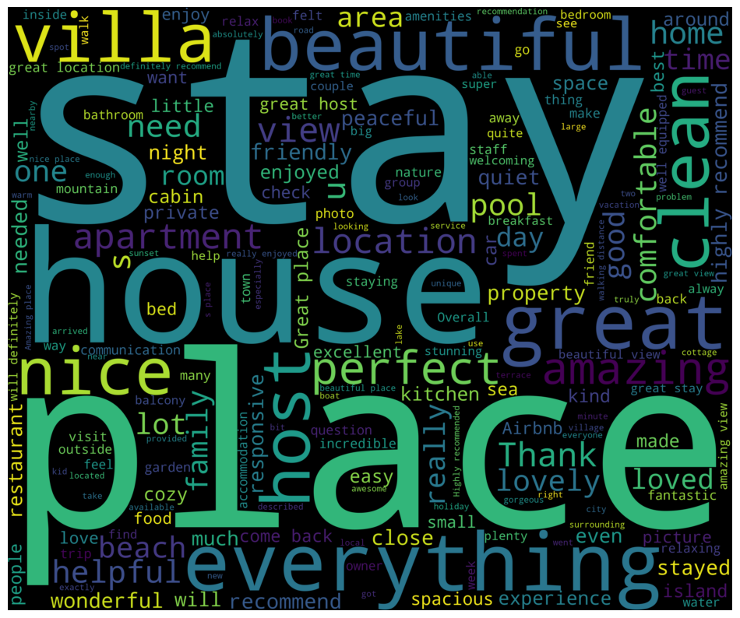
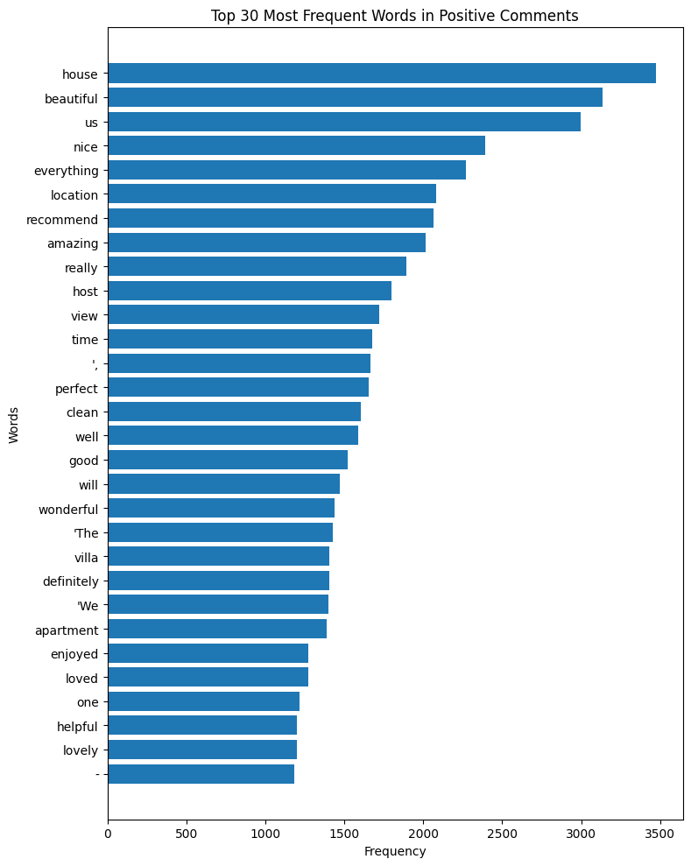
Positive Reviews Analysis

Slide 11
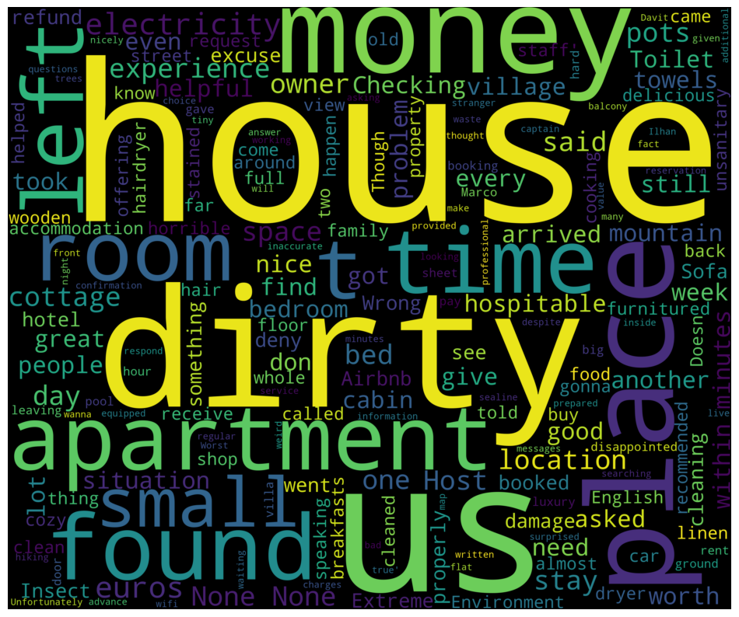
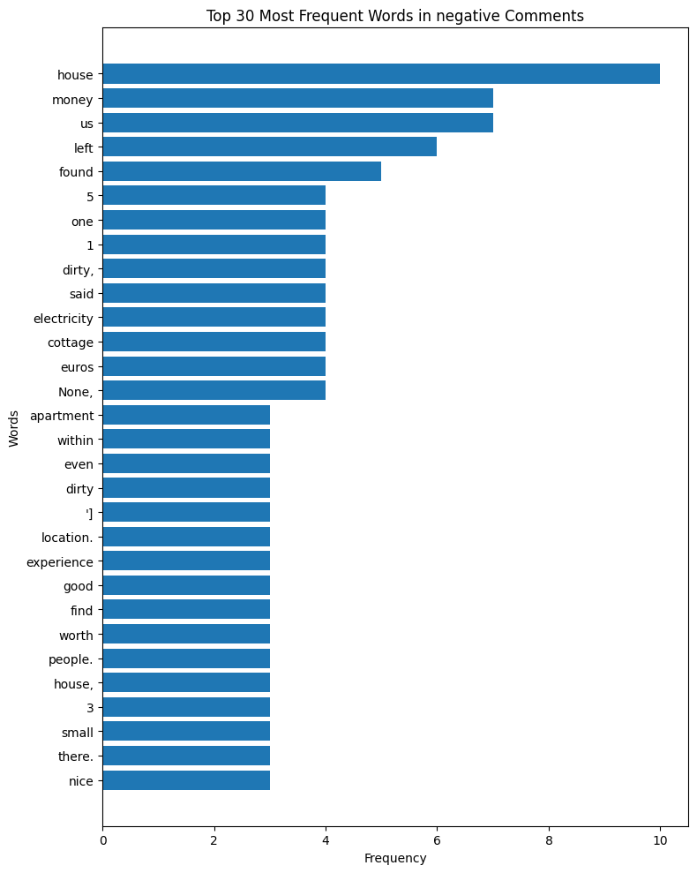
Negative Reviews Analysis

Slide 12
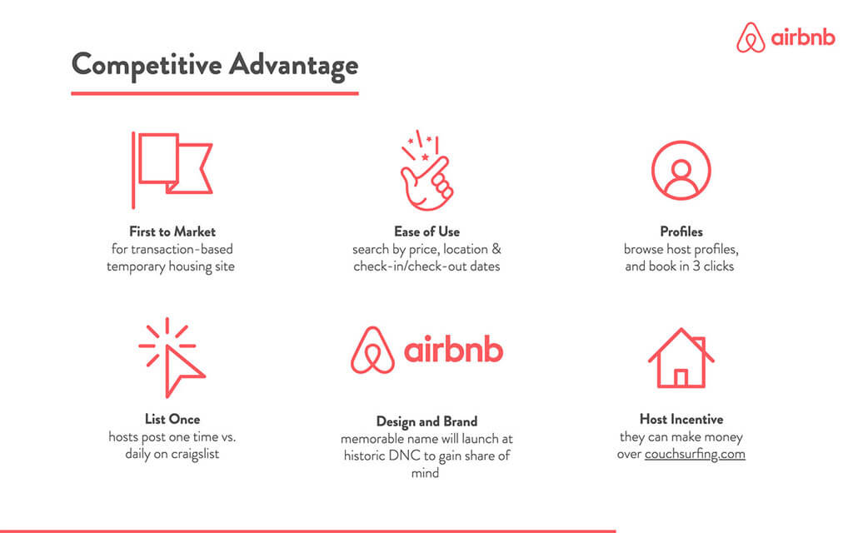

Slide 13

Marketing Strategy of Airbnb
Community-Centric Focus: Airbnb centers its marketing on building a robust community between hosts and guests. The company prioritizes long-term relationships and loyalty among its users.
Offline and Digital Fusion: Airbnb employs a fusion of offline and digital marketing strategies. This includes guerrilla marketing tactics such as unique campaigns (e.g., the floating house on River Thames) coupled with a robust digital marketing strategy involving social media and influencer partnerships.
User Experience and Market Research: The company heavily invests in understanding its user demographics and evolving preferences through data collected from its website and mobile app. This research aids in identifying niche markets, refining features, and aligning marketing strategies effectively.
Referral Program and Social Initiatives: Airbnb's successful referral program incentivizes existing users to invite new users while promoting the company's values. Additionally, impactful social initiatives like the 'We Accept' campaign emphasize diversity, equality, and social responsibility, fostering a sense of community and acceptance.

Slide 14




Competitors Marketing Strategy
Booking.com leverages social platforms to share captivating content, travel insights, and exclusive offers, effectively generating excitement and drawing new users to its platform.
Expedia's marketing channels primarily include online advertising, including social media websites, brand advertising through online and offline channels, loyalty programs, mobile apps, and direct and personalized traveler communications on its websites.
Hopper's strategy is to invest in campaigns on social channels. The company believes this is more cost efficient with the cost per app install often being lower than that paid by OTAs for clickthrough's.
VRBO is staying true to its heritage, infusing its brand with new branding but operating within the confines of Expedia’s broader company portfolio. Its role is to focus on owning the vacation rental category and maintaining leadership in key markets, particularly North America

Slide 15
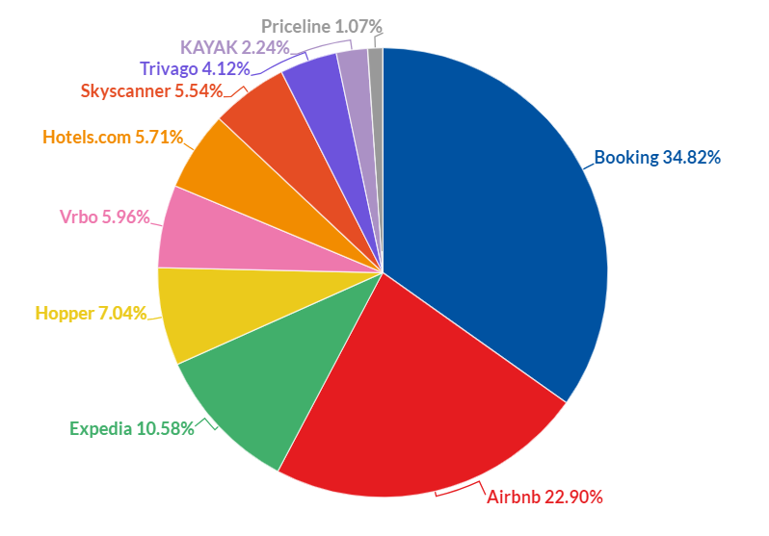
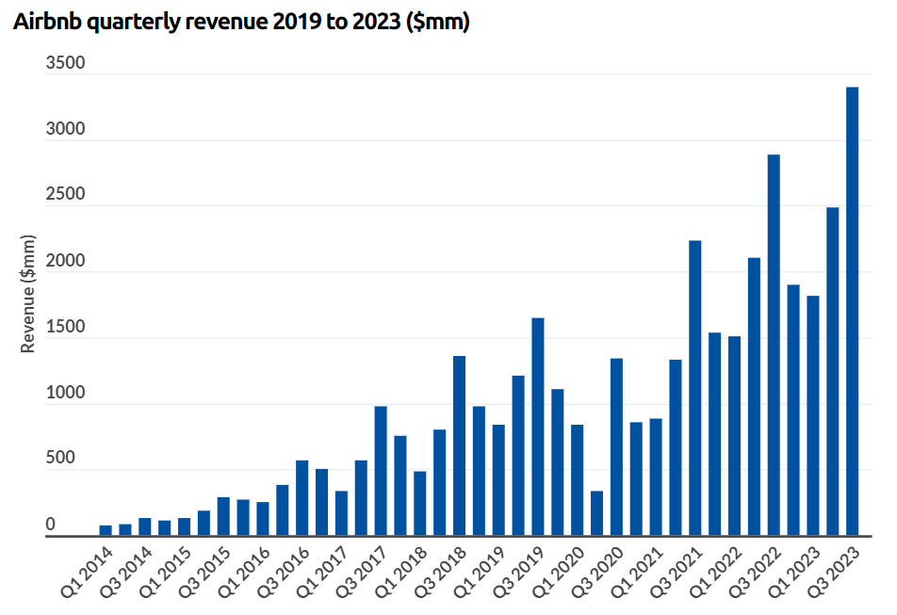
Market Share

Slide 16
STP Model for Airbnb
Demographic
Students, Employees, professionals etc.
Segmentation
Behavioral
Cheaper cost, variety, uniqueness
Psychographic
Adventurous, Ambitious, Easygoing
AIRBNB Segmentation, Targeting and Positioning
Hosts
Those who offer place
Targeting
Guests
Those who need place
Multi-Segment
Different groups of customers
Positioning
Anticipatory
Interest in unique travel

Slide 17

Conclusions
POSITIVE COMMENTS
Guests like clean and comfortable homes.
Location and neighborhood of the home/accommodation is very important
Aesthetics of the house play a big role. Renters liked homes described as beautiful, warm. They notice things like kitchen, bathroom, services.
NEGATIVE COMMENTS
Important for the host to be polite and have good communication.
Renters complained about privacy, cleanliness, toilets, insects. The most repeated was cleaning.
Space in apartments was talked by the guests.

Slide 18

Recommendations
Using reviews to improve your hosting routine
Update your photos, add details, and offer value to attract more guests.
Communicate with guests quickly and clearly
Keep your space clean, comfortable, and clutter-free
Add local touches where you can, from artwork to bath products
Give guests the experience you’d like to have if you were staying in the space
Implementing ORM(Online Reputation Management) technique to improve business reputation online.
Address negative reviews with concrete details about improvements.
Writing a short, friendly public reply to a negative review gives you the chance to share how you’re making improvements.

Slide 19

References
https://www.airbnb.ca/resources/hosting-homes/a/get-more-5-star-reviews-95
https://www.airbnb.ca/resources/hosting-homes/a/using-reviews-to-improve-your-hosting-routine-375
https://www.airbnb.ca/resources/hosting-homes/a/how-to-improve-your-listing-as-you-go-43
https://www.start.io/blog/airbnb-target-market-segmentation-customer-profile-brand-positioning/
https://research-methodology.net/airbnb-segmentation-targeting-positioning/
https://news.airbnb.com/about-us/
https://www.businessofapps.com/data/airbnb-statistics/
https://medium.com/@techinveststrat/airbnb-a-master-of-economic-disruption-and-the-ai-enhanced-future-cb846f434f65

Slide 20


